Slide 1
MaJicK Migration
Malik Awan
Justin Parker
Karika Shah

Slide 2
Objectives
Trend Analysis for:
Arctic Terns
Blue Whales
Monarch Butterflies
Humpback Whales
Notes:
We went into this project hopeful that we would be able to tie changes in the migration patterns of several species to yearly changes in climate

Slide 3
Resources
Datasets
OBIS-SEAMAP (http://seamap.env.duke.edu/)
iNaturalists (https://www.inaturalist.org/)
Visual Graphics
Matplotlib
Google Cloud Platform
Notes:
OBIS-SEAMAP, Ocean Biogeographic Information System Spatial Ecological Analysis of Megavertebrate Populations, is a spatially referenced online database, aggregating marine mammal, seabird, sea turtle and ray & shark observation data from across the globe.
iNaturalist helps you identify the plants and animals around you. Get connected with a community of over 750,000 scientists and naturalists who can help you learn more about nature!

Slide 4
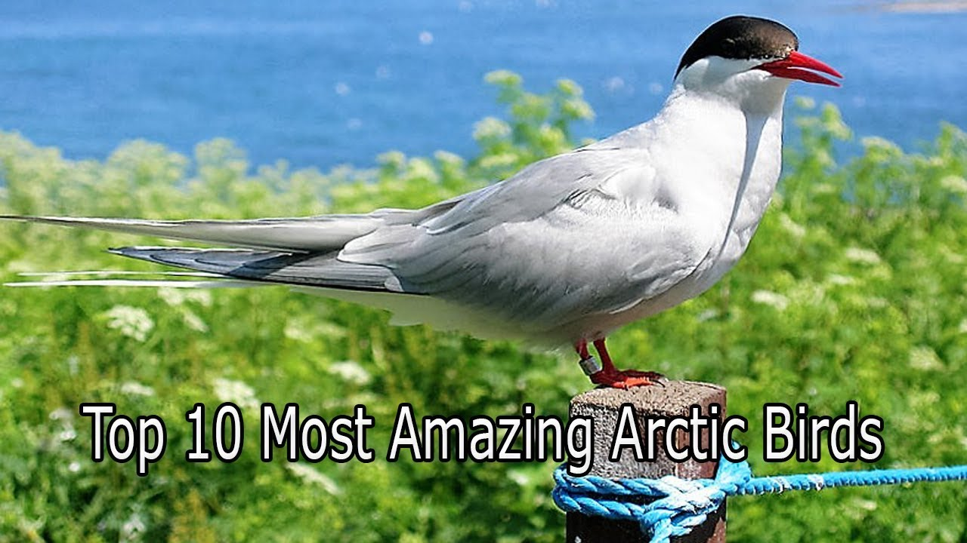
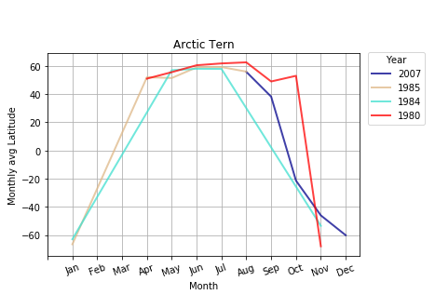
Arctic Tern
Migration Pattern and time frame
Observable Trends
Notes:
They breed in from Nov through Jan in South pole

Slide 5
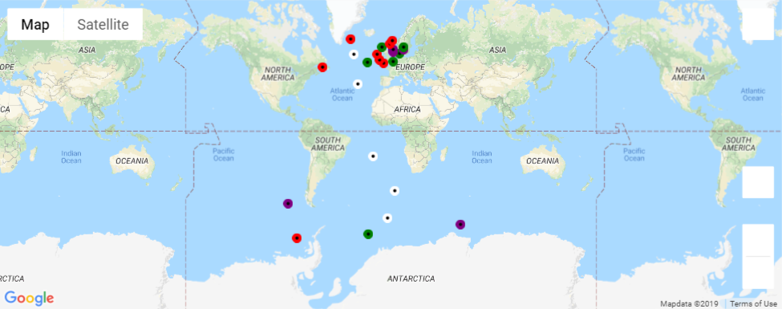
Arctic Tern
Legend
Color | Year
White | 2007
Green | 1985
Purple | 1984
Red | 1980

Slide 6
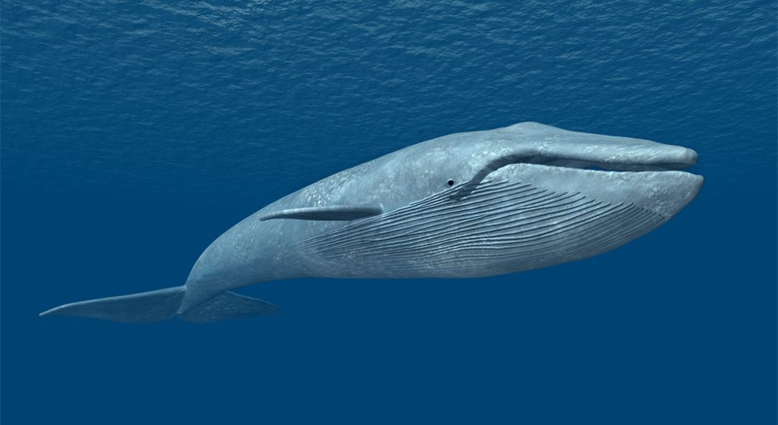
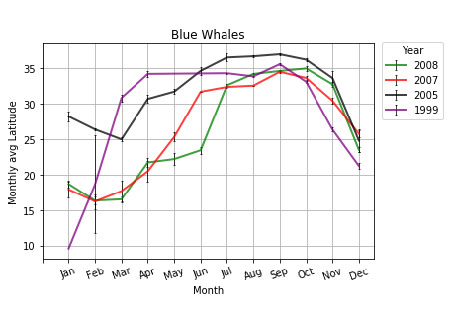
Blue Whales
Migration Pattern and time frame
Observable Trends

Slide 7
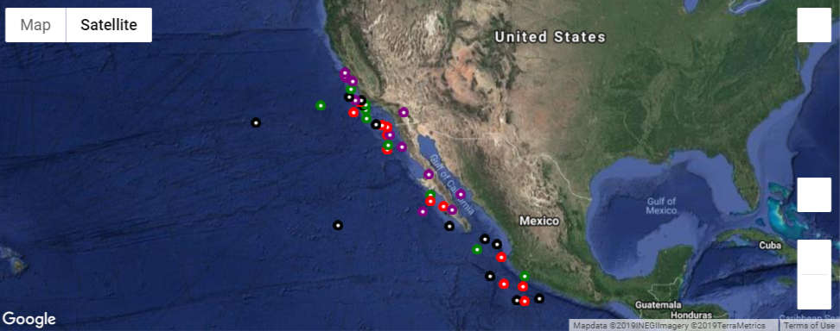
BLUE WHALES
Legend
Color | Year
Black | 2008
Red | 2007
Purple | 2005
Green | 1999

Slide 8
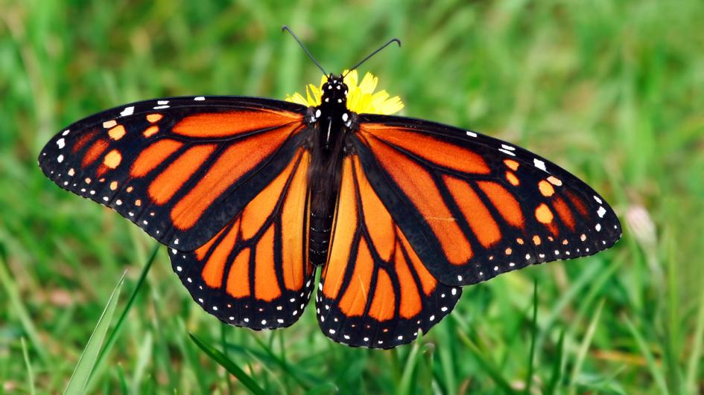
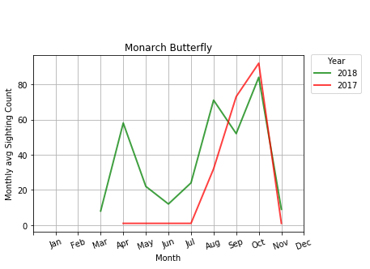
Monarch Butterfly
Migration Pattern and time frame
Observable Trends

Slide 9
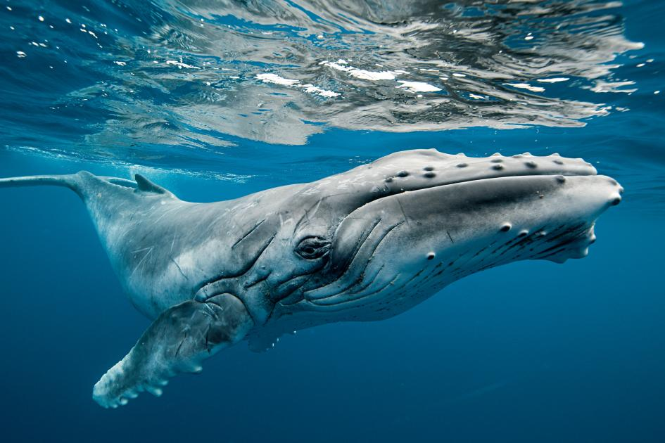
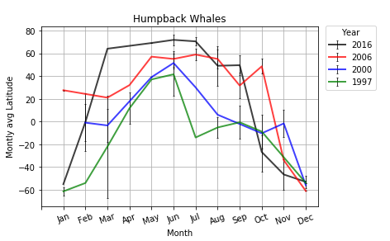
Hump-back Whale
Migration Pattern and time frame
Observable Trends

Slide 10
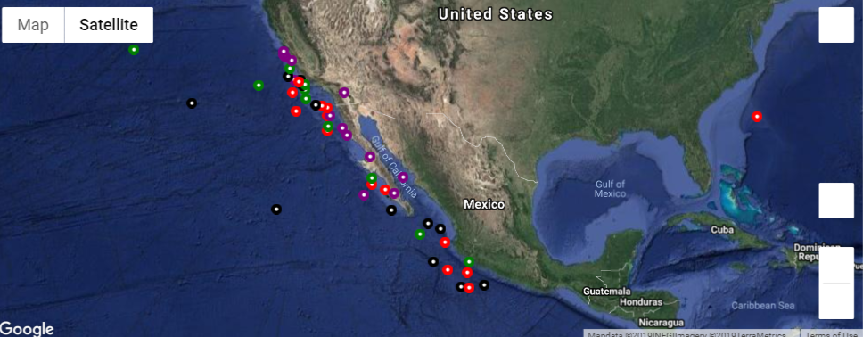
Hump-back Whale
Legend
Color | Year
Black | 2016
Red | 2006
Purple | 2000
Green | 1997

Slide 11
Summarize
Keys observations/ trend analysis – TO BE UPDATED BY JUSTIN
Notes:
Conclusion could be different if we had the weather data : Due to government shutdown, we could not get to show if the climate change impacted the migratory pattern

Slide 12
Thank you

